Slide 1
Group Number: 1
QYF Virtual Internship
Group Members(Presenters):
Minentle Vikwa
Kgotlelelo Mokwana
14/01/2026

Slide 2
Section 1: Operational Risk
Employee Attrition Analysis: Insights & Recommendations
QYF Virtual Internship 1

Slide 3
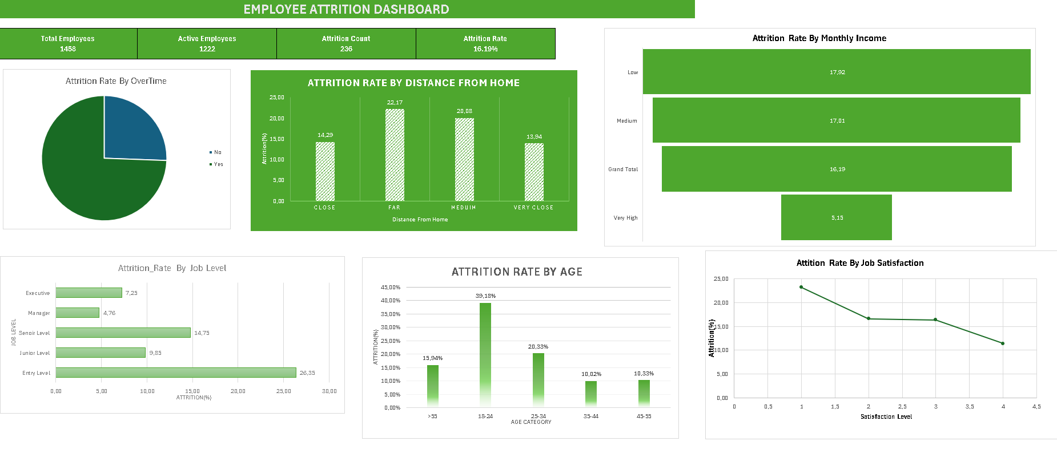
Section 1: Operational Risk
Part 2: Data Cleaning
What was the goal of your analysis? What questions were you trying to answer and why do they matter?
What were the interesting findings from your analysis and why are they important for the business?
What are some of the drivers of attrition based on your data analysis?
Provide recommendations to solve the attrition problem based on your data analysis results. You must also describe the potential business impact of your recommendation:
Why is this a good recommendation?
What benefits will the business achieve?
Provide insights​
QYF Virtual Internship 2

Slide 4
Section 1: Operational Risk
GOAL:
To analyze employee attrition patterns and identify key factors driving turnover, enabling data-driven actions to improve retention.
WHAT WERE WE AIMING TO ANSWER?
What is the overall attrition rate?
Which employee groups are most at risk?
Which workplace factors are linked to higher attrition?
What targeted interventions can reduce turnover
QYF Virtual Internship 2

Slide 5
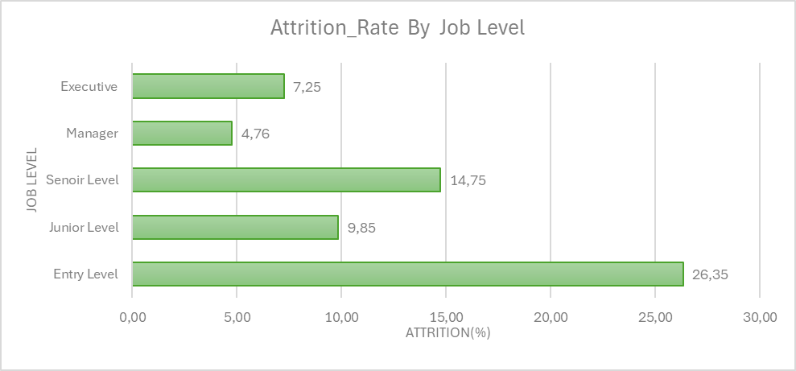
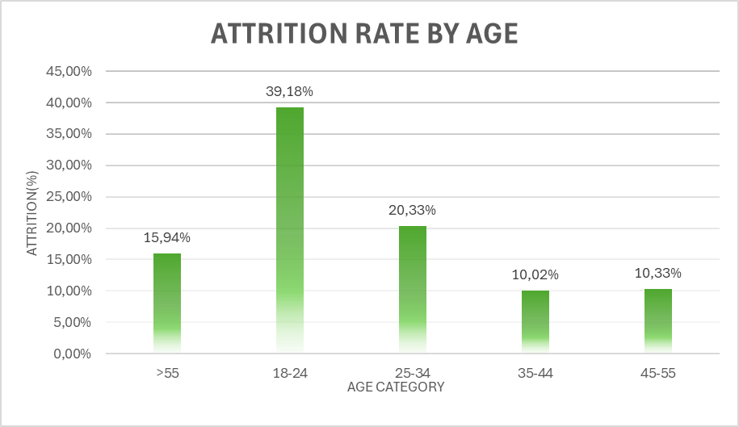
Section 1: Operational Risk
WHY DOES IT MATTER?
Employee attrition raises hiring and training costs, disrupts team productivity, and creates operational risk.
Employee Attrition Dashboard

Slide 6
Interesting Findings
What we found was:
Attrition is highest among early-career employees
Entry-level staff attrition rate: 26.35%
Ages 18–24 show the highest attrition rate: 39.18%
Attrition decreases as job level and age increase
Suggests loss of talent early due to:
Onboarding challenges
Unmet job expectations
Limited early-career growth opportunities
Business impact:
Higher recruitment and training costs
Disrupted team productivity
Weakened long-term talent pipeline

Slide 7
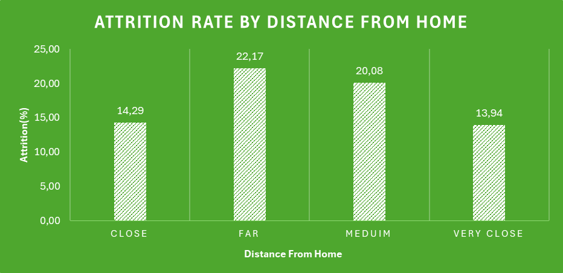
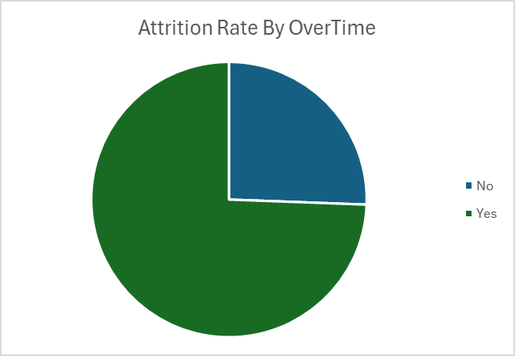
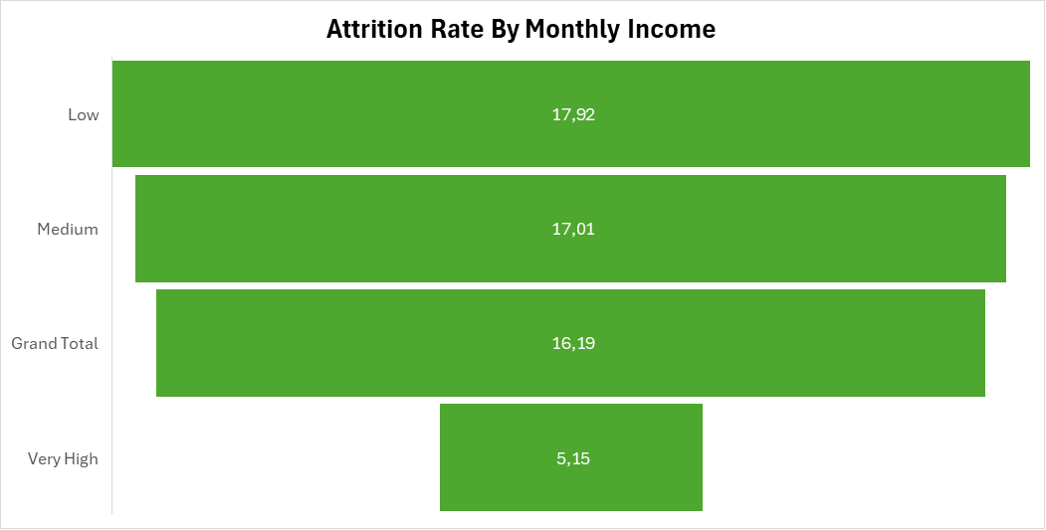
OTHER DRIVERS OF ATTRITION
r

Slide 8
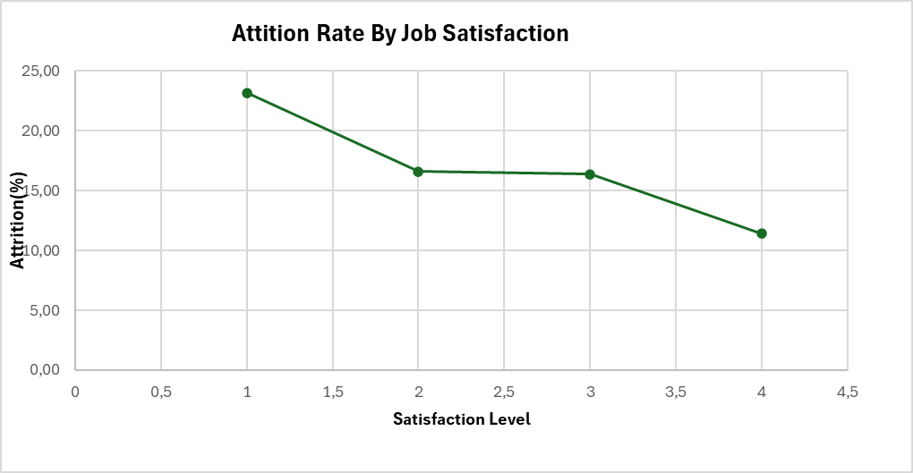
DRIVERS OF ATTRITION
Higher attrition linked to heavy workload and lower pay
Employees working overtime leave more → burnout risk
Attrition highest in Low (17.92%) and Medium (17.01%) income bands
Much lower in Very High income (5.15%)
Suggests pay may not feel worth the job demands for lower-paid staff
Job satisfaction is a key driver
Attrition decreases as satisfaction rises (Level 1 → Level 4)
Related contributing pressures:
Poor work–life balance
High workload
Pay not matching effort
Commuting distance
Overall insight: Attrition risk rises when work strain is high and rewards (pay/satisfaction) are low

Slide 9
Recommendations
Strengthen early-career retention
Structured onboarding, mentoring, regular check-ins, clear growth paths
Targets highest-risk group (entry-level & ages 18–24)
Benefit: Lower hiring costs, faster productivity, stronger talent pipeline
Reduce workload strain & improve work–life balance
Manage workloads and control excessive overtime
Addresses burnout and dissatisfaction drivers
Benefit: Better retention, stable performance, less absenteeism
Improve compensation in lower income bands
Enhance pay progression and performance incentives
Reduces gap between effort and reward
Benefit: Higher motivation, improved retention, lower replacement costs
Support employees with long commutes
Flexible work options or commute assistance
Reduces fatigue and daily strain
Benefit: Higher retention, improved well-being, more reliable staffing

Slide 10
Conclusion
QYF Virtual Internship 4

Slide 11
Thank You
QYF Virtual Internship 5

